Slide 1
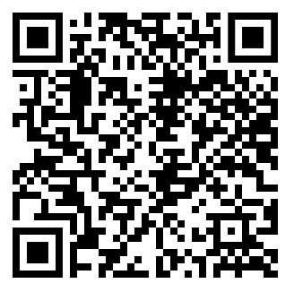
Digital Self Defense
Staying safe in the digital age
Jason Chambers
© 2019

Slide 2
Q. How do they get hold of my login/password (credentials)?
Q. What can I do to avoid becoming a victim?
Goals:
Provide answers
Teach you how to boost your defenses
Q. Am I being targeted?
Q. Why do businesses keep getting hacked?
Q. Why is it so hard for businesses to avoid getting hacked?

Slide 3
~$600B lost to cybercrime each year (~1% of global GDP)
Center for Strategic and International Studies – Feb 2018

Slide 4
Low
High
Your defenses
Risk
Consequences
Cost to adversary

Slide 5
How do they get hold of my login/password?

Slide 6
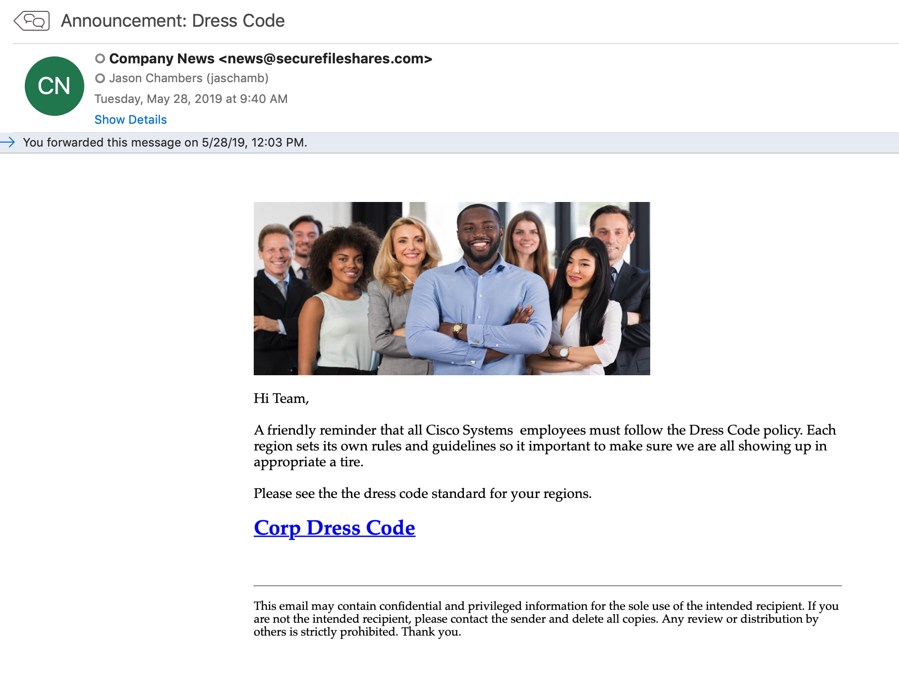
Social Engineering
1. You are tricked into providing them
Phishing
90% of all attacks on enterprise networks are the result of a successful phishing attack.
97% of people are unable to identify a sophisticated phishing email

Slide 7
Malicious Software
Spyware
e.g. Key Loggers
2. Malware
How does it get installed?
Social Engineering
Infiltrate
Vulnerable devices
Question – What is the pattern here?

Slide 8
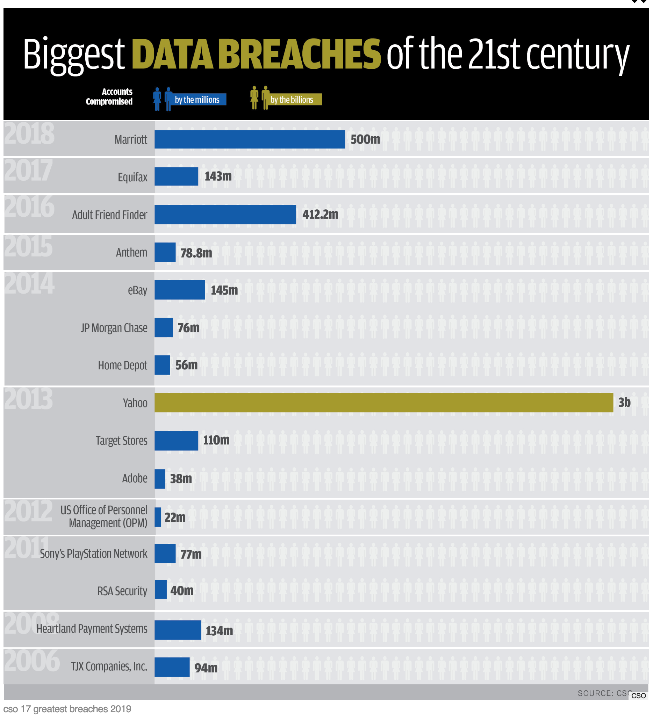
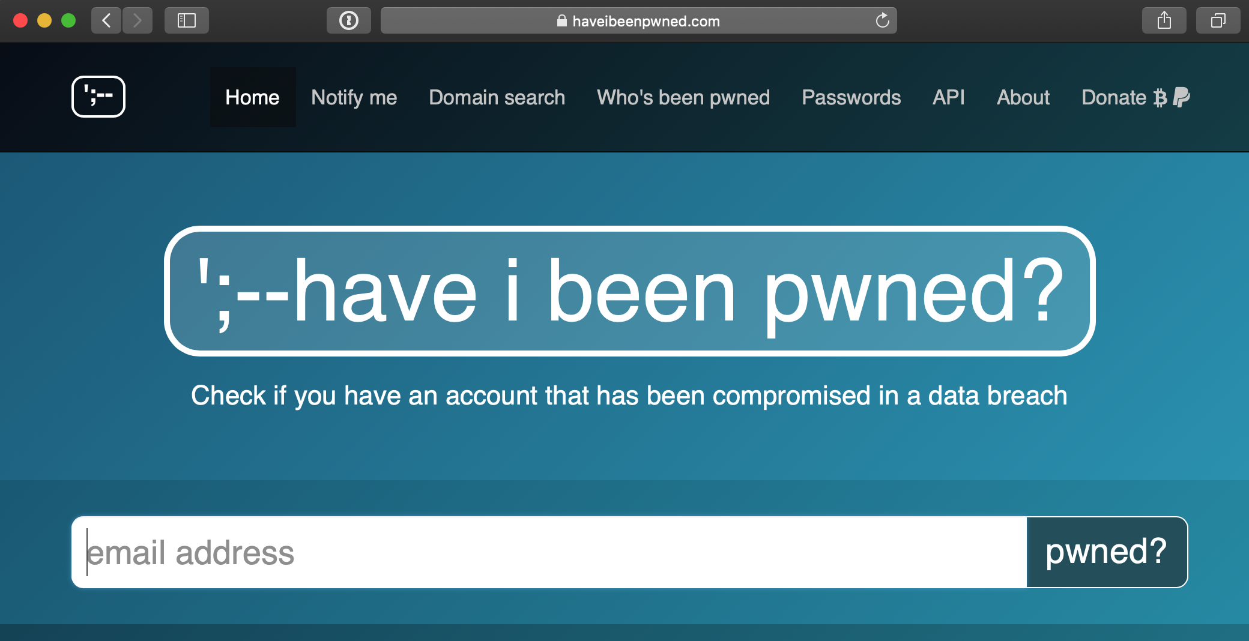
Credentials Spill
Data bounty put up for sale on Dark Web
3. Data Breach
Account Takeover

Slide 9
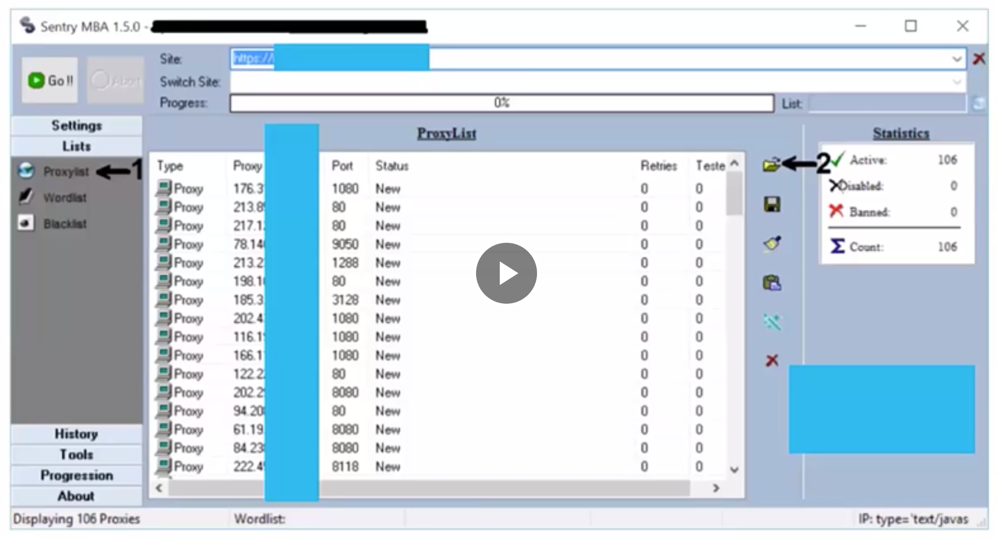
Test spilled credentials on other sites
Evade detection
4. Credential Stuffing
Automated attack
Using botnet/infected devices
Question – what might you do to protect yourself from a Credential Stuffing attack?
Question – with your new found knowledge, do you think you are being targeted?

Slide 10
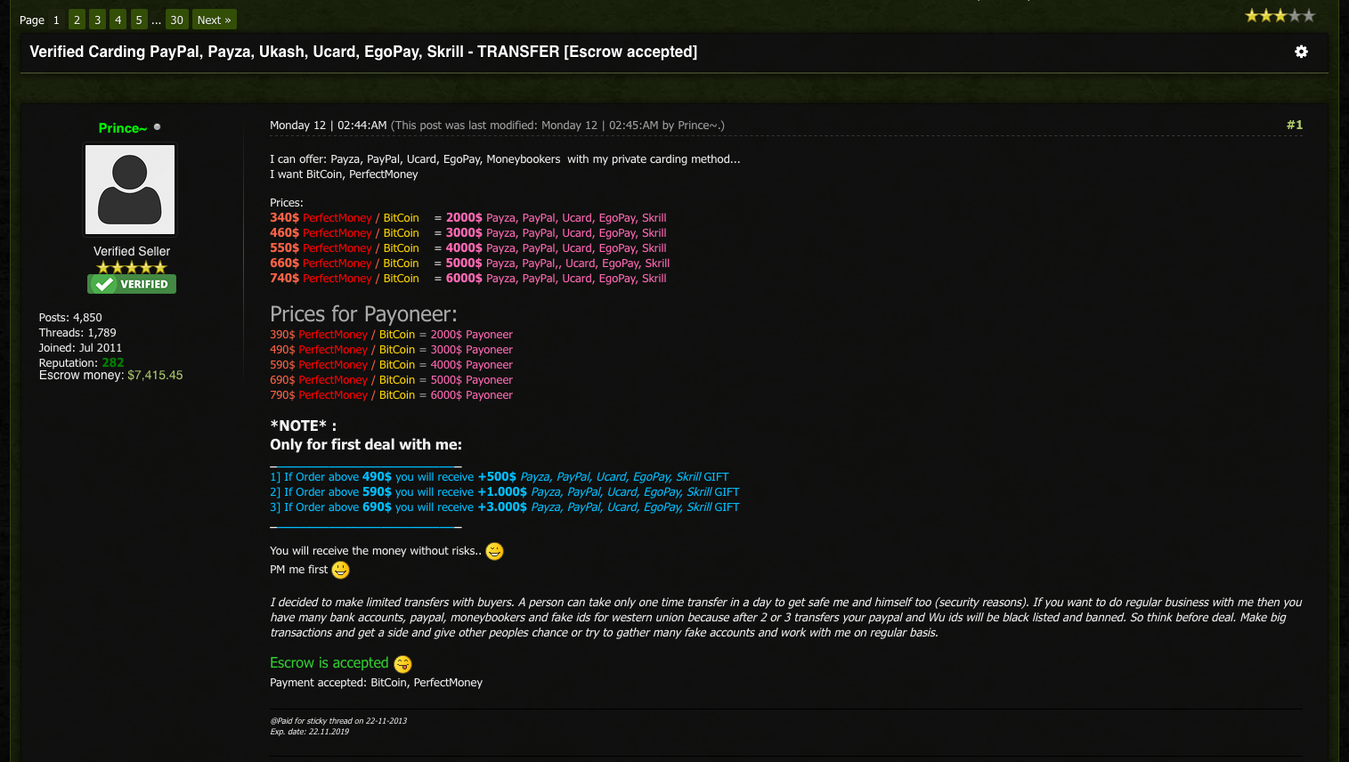
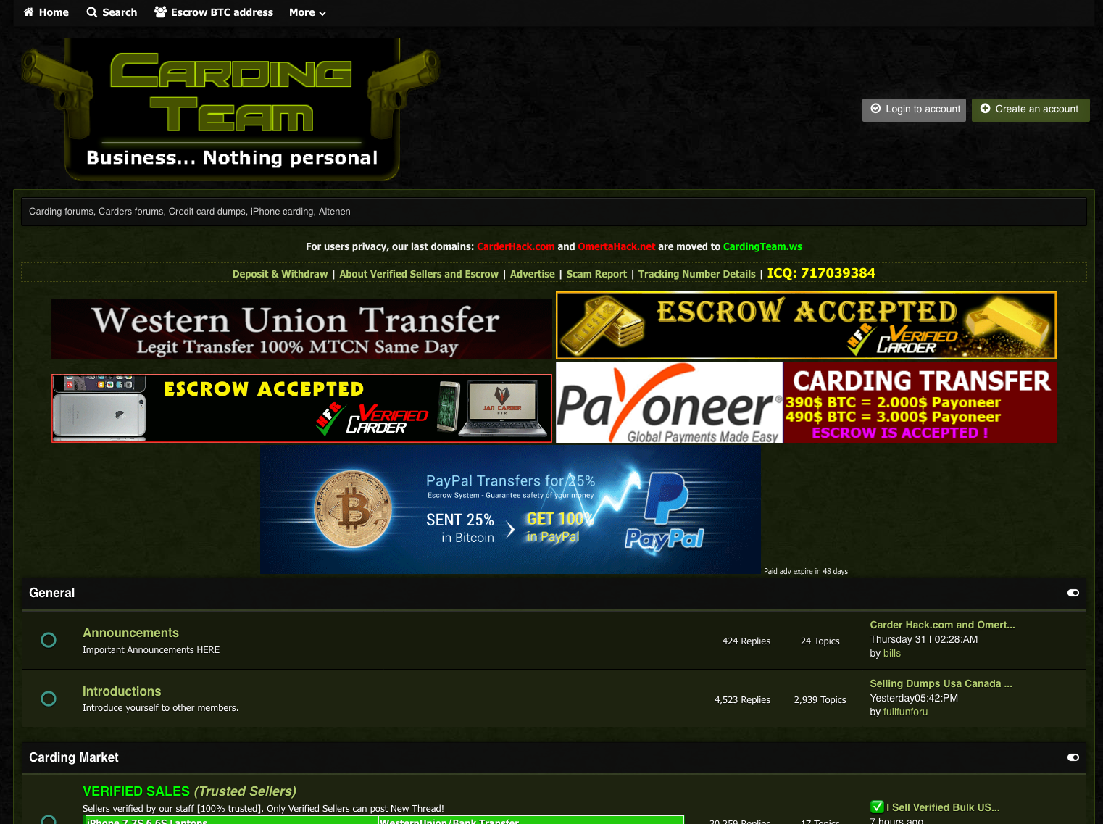
Previously spilled credentials
5. They can bought on the Dark Web
For $20-$200
Wait? What? Anybody care to do the math?
Q – What is more valuable? – your e-mail credentials or your banking credentials?

Slide 11
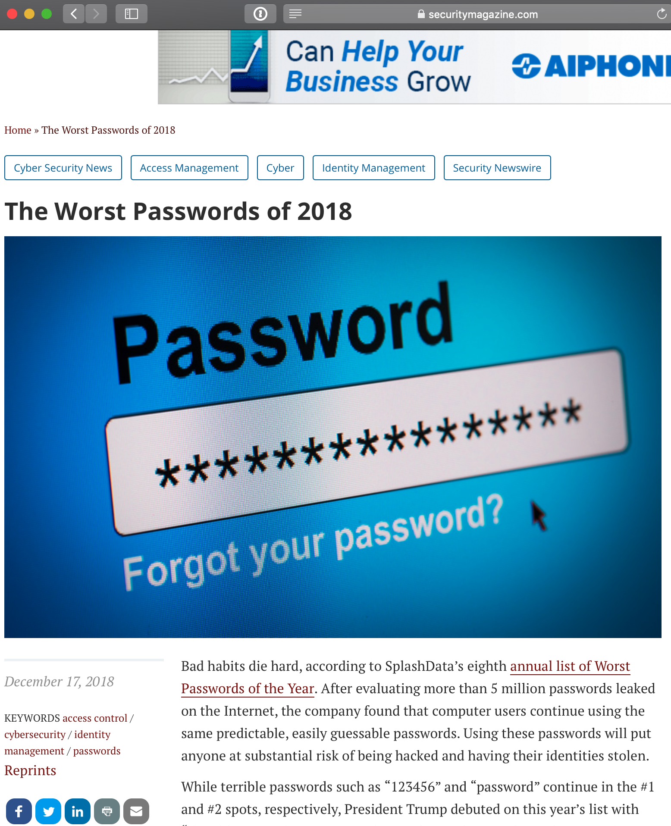
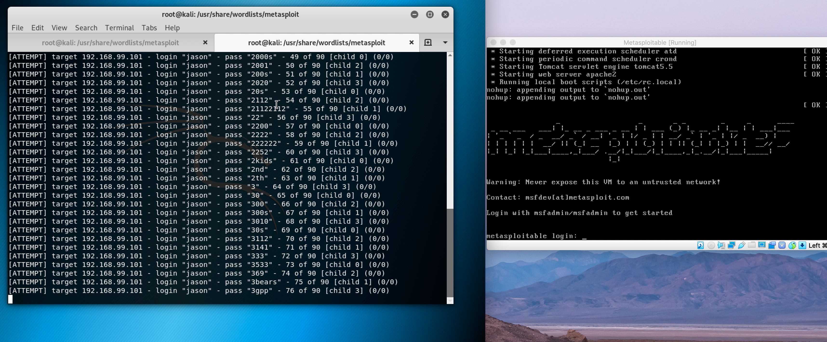
Targeted?
Expect big returns
6. Brute force attempts
Slow (expensive)
Simple passwords can be cracked fairly quickly
Question – what might you do to frustrate somebody who is conducting a brute-force attack?
If we have time, I can demo a brute-force attack

Slide 12
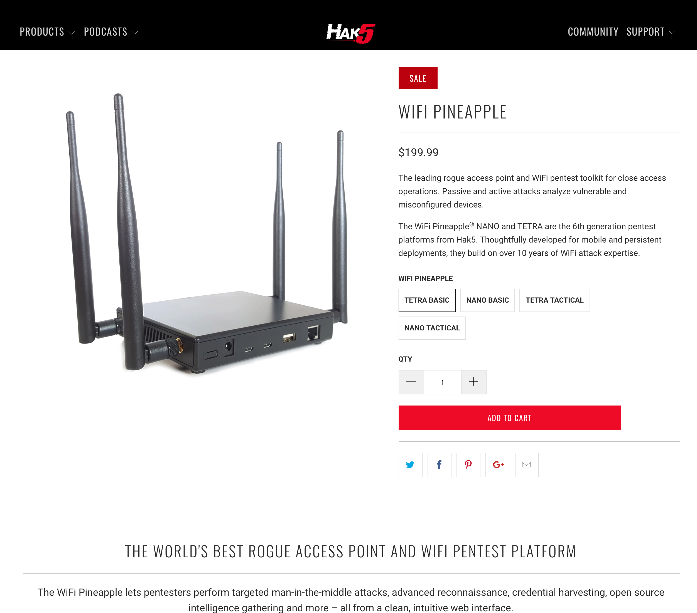
Think of it as a public swimming pool
Man-in-the-middle attacks
7. Public Wifi
Wifi sniffing

Slide 13
8. Do you have them written down?

Slide 14
What can I do to avoid becoming a victim?

Slide 15
Unless you choose to live off the grid, it’s impossible to avoid risk altogether
You can however take steps to reduce your risk
Ready?

Slide 16
Use a Password Manager

Slide 17
Change all your on-line passwords using a different strong password for each

Slide 18
Turn on 2FA for your accounts (start with e-mail)

Slide 19
Find out if you have been compromised (hint: you probably have been already)

Slide 20
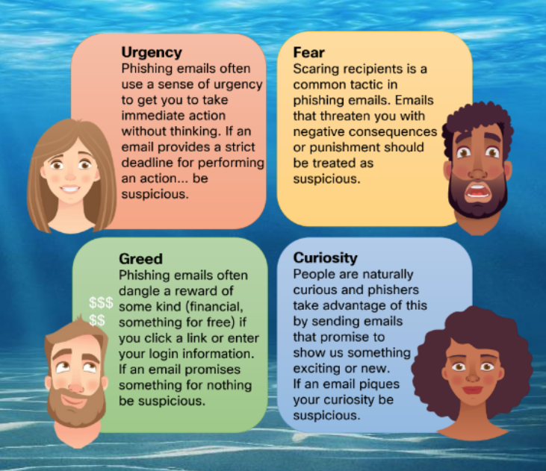
Learn the signs of phishing campaigns

Slide 21
Never give out personal or sensitive information until you have verified who you are talking to

Slide 22
E-mail (and SMS) is not confidential – encrypt sensitive files before sending them

Slide 23
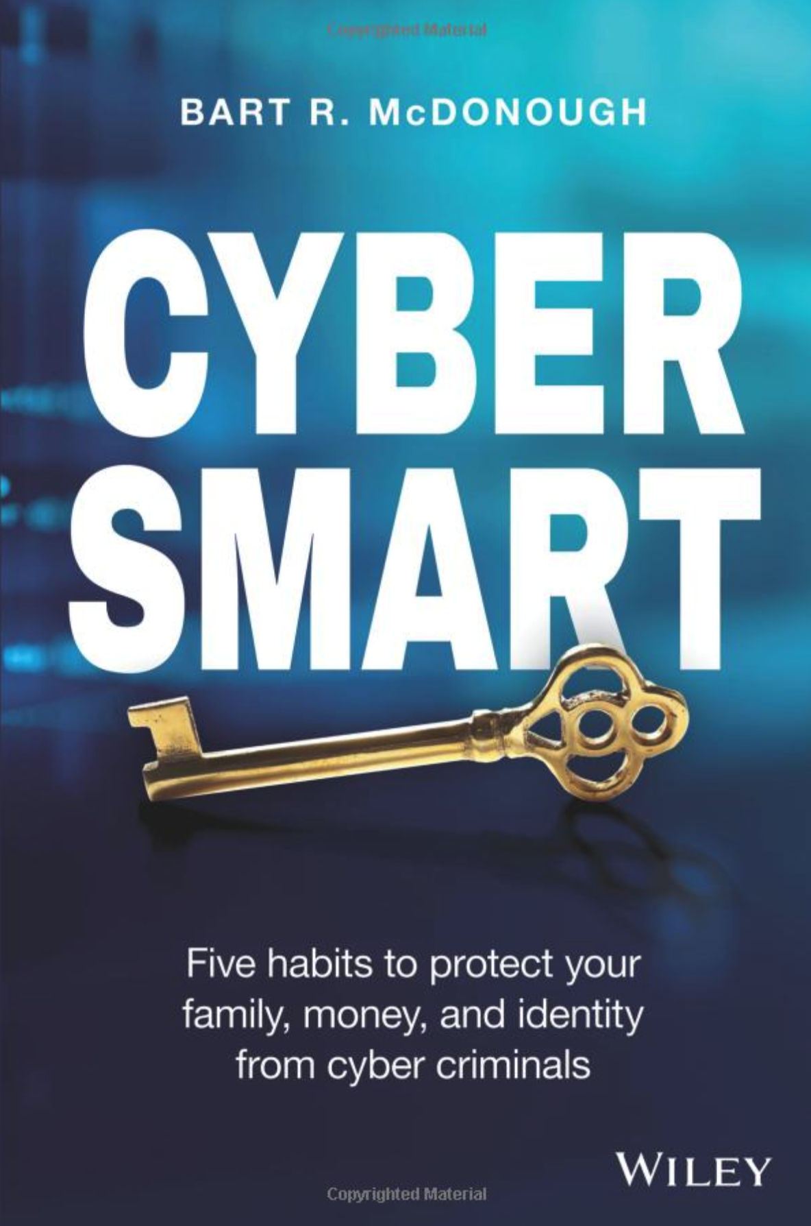
Buy this book

Slide 24
Freeze your credit

Slide 25
Monitor your credit

Slide 26
Monitor your banking activity (alerts)

Slide 27
Confirm wiring instructions over the phone AND lookup routing number and IBAN – never blindly trust e-mail messages

Slide 28
Be wary of on-line dating scams

Slide 29
Know it is easy to spoof Caller ID – it is not the IRS or Technical Support that is calling you

Slide 30
Invest in a secure on-line backup service (if you want to recover from a Ransomware attack)

Slide 31
Turn on hard-drive encryption – in case your laptop is stolen

Slide 32
Wipe clean your old Mac/PC/Device before selling/donating it

Slide 33
Take care using free public Wifi – use a VPN
(Be careful at airports especially)

Slide 34
Check https://haveibeenpwned.com/

Slide 35
Spread the word

